Slide 1
Project Management
CT050-3-3-PRMGT
05: Planning Projects
Part 2 - Time and Cost

Slide 2
Topic & Structure of The Lesson
Knowledge area | Planning process | Outputs
Project schedule management | Plan schedule management Define activities Sequence activities Estimate activity durations Develop schedule | Schedule management plan Activity list Activity attributes Milestone list Change requests Project management plan updates Project schedule network diagrams Project documents updates Activity duration estimates Basis of estimates Project documents updates Schedule baseline Project schedule Schedule data Project calendars Project management plan updates Project documents updates
Project cost management | Plan cost management Estimate costs Determine budget | Cost management plan Cost estimates Basis of estimates Project documents updates Cost baseline Project funding requirements Project documents updates

Slide 3
Learning Outcomes
At the end of this topic, You should be able to
List several planning processes and outputs for project schedule and cost management
Describe the project schedule management planning processes
Understand how to find the critical path and its implications on timely project completion
Explain the concept of critical chain scheduling and how it can be used in organizations
Discuss the three project cost management planning processes
Create a cost management plan, cost estimate, basis of estimates, cost baseline, and project funding requirements

Slide 4
Key Terms You Must Be Able To Use
If you have mastered this topic, you should be able to use the following terms correctly in your assignments and exams:
project documents updates
final products, services, or result transition
a final report
updates to organizational process assets

Slide 5
Project Time Management
Project time management involves the processes required to ensure timely completion of a project.
The main planning tasks performed include:
Planning schedule management,
Defining activities,
Sequencing activities,
Estimating activity durations,
Developing the project schedule
The main documents produced are:
Schedule management plan,
Activity list and attributes,
Milestone list,
Network diagram,
Activity duration estimates,
Schedule baseline,
Project schedule,
Project calendars

Slide 6
Contents of a Schedule Management Plan
Scheduling methodology and tools used to create a schedule model, if required
Release and iteration length, or time-boxed periods
Level of accuracy required for activity duration estimates
Units of measure, such as staff hours, days, or weeks
Organizational procedure links
Project schedule model maintenance
Control thresholds for monitoring schedule performance, such as a percentage deviation from the baseline plan
rules of performance measurement, especially if earned value management is used
Formats and frequency for schedule reports

Slide 7
Defining Activities
An activity is a distinct, scheduled portion of work performed during the course of a project.
The goal of the defining activities process is to ensure that project team members have a complete understanding of all the work they must do as part of the project scope so that they can start scheduling the work.
For example, how can you estimate how long it will take or what resources you need to prepare a report if you don’t have more detailed information on the report?

Slide 8
Creating the Activity List and Attributes
The activity list is a tabulation of activities to be included on a project schedule.
It should include the activity name, an activity identifier or number, and a brief description of the activity.
The activity attributes provide schedule-related information about each activity, such as predecessors, successors, logical relationships, leads and lags, resource requirements, constraints, imposed dates, and assumptions related to the activity.
Both should be in agreement with the WBS and WBS dictionary and be reviewed by key project stakeholders

Slide 9
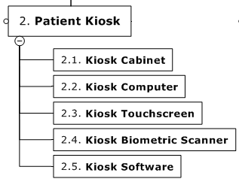
Example: WBS 100% Rule
When a deliverable is decomposed into smaller deliverables (and eventually the work packages), all work required for a deliverable is included in its sub-deliverables, known as the WBS 100% rule.

Slide 10
Creating a Milestone List
A milestone is a significant point or event in a project.
It often takes several activities and a lot of work to complete a milestone, but the milestone itself is like a marker to help identify necessary activities.
There is usually no cost or duration for a milestone.
Project sponsors and senior managers often focus on major milestones when reviewing projects.
Sample milestones for many projects include:
Sign-off of key documents
Completion of specific products
Completion of important process-related work, such as awarding a contract to a supplier

Slide 11
Sample Milestone List

Slide 12
Sequencing Activities
Sequencing activities involves:
Reviewing the activity list and attributes,
project scope statement,
milestone list to determine the relationships or dependencies between activities.
A dependency or relationship relates to the sequencing of project activities or tasks
For example, does a certain activity have to be finished before another one can start?
Can the project team do several activities in parallel?
Can some overlap?
Sequencing activities has a significant impact on developing and managing a project schedule

Slide 13
Reasons for Creating Dependencies
Mandatory dependencies are inherent in the nature of the work being performed on a project
You cannot hold training classes until the training materials are ready
Discretionary dependencies are defined by the project team
A project team might follow good practice and not start detailed design work until key stakeholders sign off on all of the analysis work
External dependencies involve relationships between project and non-project activities
The installation of new software might depend on delivery of new hardware from an external supplier. Even though the delivery of the new hardware might not be in the scope of the project, it should have an external dependency added to it because late delivery will affect the project schedule
Internal dependencies are within the project team’s control, such as testing a machine that must be first assembled, where all the work is done inside the team.

Slide 14
Network Diagrams
Network diagrams are the preferred technique for showing activity sequencing
A network diagram is a schematic display of the logical relationships among, or sequencing of, project activities:
In the activity-on-arrow (AOA) approach, or the arrow diagramming method (ADM), activities are represented by arrows and connected at points called nodes (starting and ending point of an activity) to illustrate the sequence of activities; only show finish-to-start dependencies (most common type of dependency)
The precedence diagramming method (PDM) (also called activity on node, or AON) is a network diagramming technique in which boxes represent activities These are more widely used as they can show all dependency types

Slide 15
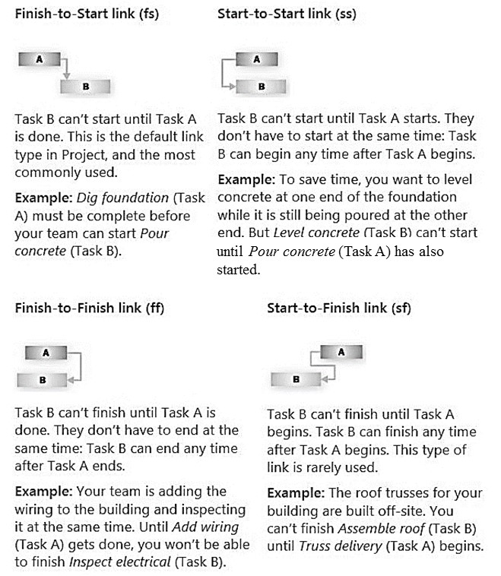
Activity Dependency Types

Slide 16
Program Evaluation and Review Technique (PERT)
Program Evaluation and Review Technique (PERT) is a network analysis technique used to estimate project duration when there is a high degree of uncertainty about the individual activity duration estimates.
PERT weighted average =
optimistic time+4×most likely time+ pessimistic time
6
Example: PERT weighted average =
(1 workday+4×2 workdays+9 workdays)/6 = 3 workdays
Instead of using the most likely time of two workdays for this task, you’d use three workdays with a PERT estimate

Slide 17
Developing the Project Schedule
Schedule development uses the results of all the preceding project time management processes to determine the start and end dates of project activities and of the entire project .
The resulting project schedule is often shown on a Gantt chart, a standard format for displaying project schedule information by listing project activities and their corresponding start and finish dates in a calendar format.
The ultimate goal of schedule development is to create a realistic project schedule that provides a basis for monitoring project progress for the time dimension of the project

Slide 18
Critical Path Analysis
Critical path method (CPM)—also called critical path analysis—is a network diagramming technique used to predict total project duration
A critical path for a project is the series of activities that determine the earliest time by which the project can be completed. It is the longest path through the network diagram and has the least amount of slack or float
Slack or float is the amount of time an activity may be delayed without delaying a succeeding activity or the project finish date
The longest path or the path containing the critical tasks is what is driving the completion date for the project

Slide 19
Project Cost Management
Project cost management includes the processes required to ensure that a project team completes a project within an approved budget.
The main planning tasks are planning cost management, estimating costs, and determining the budget.
The main documents produced include a cost management plan, a cost estimate, and a cost performance baseline
The purpose of this process is to determine the policies, procedures, and documentation for planning, managing, executing, and controlling project costs
The project team holds meetings, consults with experts, and analyzes data to help produce a cost management plan, which becomes a component of the project management plan

Slide 20
Possible Contents of a Cost Management Plan
Units of measure, such as staff hours or days or a lump sum amount, currency to be used, inflation assumptions, etc.
Level of precision for cost estimates, such as how to round numbers
Level of accuracy, such as +/-10%
Organizational procedure links
Control thresholds for monitoring cost performance, such as a percentage deviation from the baseline plan
Rules of performance measurement, especially if earned value management is used
Reporting formats and frequency for cost reports
Additional details about cost activities, such as strategic funding choices, procedures to account for currency fluctuations, and procedures for recording costs

Slide 21
Estimating Costs
Project teams normally prepare cost estimates at various stages of a project, and these estimates should be fine-tuned as time progresses
It is also important to provide supporting details for the estimates, including ground rules and assumptions (sometimes called the basis of estimates)
A large percentage of total project costs are often labor costs, so it is important to do a good job estimating labor hours and costs

Slide 22
Cost Estimating Techniques
Analogous estimates, also called top-down estimates, use the actual cost of a previous, similar project as the basis for estimating the cost of the current project. This technique requires a good deal of expert judgment and is generally less costly than others are, but it can also be less accurate
Bottom-up estimates involve estimating individual activities and summing them to get a project total. This approach can increase the accuracy of the cost estimate, but it can also be time intensive and, therefore, expensive to develop
Parametric modeling uses project characteristics (parameters) in a mathematical model to estimate project costs

Slide 23
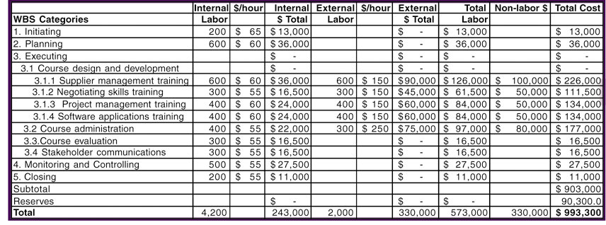
Sample Cost Estimate
Assumptions:
Internal labor rates include benefits and overhead. Average hourly rates based on skill levels and departments.
External labor rates are based on historical average; may change as contracts are awarded.
Non-labor costs include purchasing licenses for using training materials, books, CD/ROMs, travel expenses, etc.; may change as contracts are awarded.
Reserves are calculated by taking 10% of the subtotal for the estimate. These contingency reserves are based on known risks.

Slide 24
Cost Budgeting
Project cost budgeting involves allocating the project cost estimate to tasks over time
The tasks are based on the work breakdown structure for the project
The main goal of the cost budgeting process is to produce a cost baseline, or time-phased budget, that project managers use to measure and monitor cost performance

Slide 25
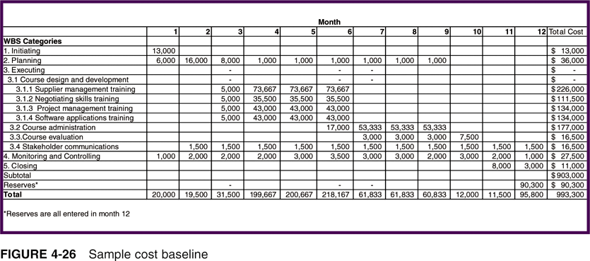
Sample Cost Baseline

Slide 26
Quick Review Question

Slide 27
Summary of Main Teaching Points
Planning processes for time management include:
Planning schedule management,
defining activities,
sequencing activities,
estimating activity durations,
developing a project schedule.
It is also important to understand critical path analysis to make schedule trade-off decisions.
Planning processes for cost management include:
planning cost management,
estimating costs,
determining the project budget.
There are several methods for creating cost estimates, such as analogous,
bottom-up, and parametric. A cost baseline is a time-phased budget that
project managers use to measure and monitor cost performance.

Slide 28
Question and Answer Session
Q & A

Slide 29
What we will cover next
Assignment Clinic
Revision

Slide 30
What we will cover next
06 Planning Projects Part 3 (Integration & Scope)

